Slide 1
ArchiMate®
Core Principles

Slide 2
Language
Notation
Deliverables
ELEMENTS
RELATIONSHIPS
VIEWPOINTS
Notes:
WHAT I CAN SEE
PARTICULARS TO FOCUS ON
DESCRIBE LOGICALLY
BE COHERENT

Slide 3
Language
Notation
Deliverables
ELEMENTS

Slide 4

ACTIVE STRUCTURE elements are defined as an entity that IS CAPABLE OF performing BEHAVIOUR
Notes:
A chef in a kitchen DOES THE WORK

Slide 5

PASSIVE STRUCTURE elements are defined as an OBJECT on which on which behaviour is performed
Notes:
They do it to INGREDIENTS

Slide 6

BEHAVIOUR elements are defined as a unit of activity PERFORMED BY one or more
ACTIVE ELEMENTS
Notes:
“EATING” and “TASTING” are words that describe what is BEING DONE – the BEHAVIOUR.

Slide 7



AS A…
I WILL…
WITH…
Farmer
Harvest grain
Tractors
Celebrity
Act
A script
Chef
Cook
Ingredients
Notes:
Other examples?

Slide 8

3: Business
4: Application
5: Technology
Active
Behavioural
Passive
Active
Behavioural
Passive
Active
Behavioural
Passive
Specification
Notes:
The manual describes ALL the elements in these groups

Slide 9
What are the ACTIVE elements in the Technology layer? What are the PASSIVE elements in the Application layer? What are the BEHAVIOUR elements of the Business layer?
Notes:
HAND OUT Archimate Reference Card

Slide 10
Language
Notation
Deliverables
RELATIONSHIPS
Notes:
BIGGER PICTURE
REFLECT on SIMILARITIES INSIDE and FROM EXPERIENCE

Slide 11
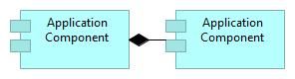
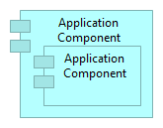
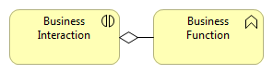
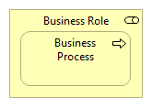
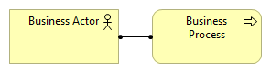
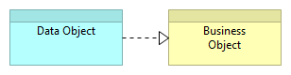
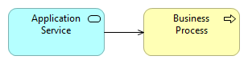
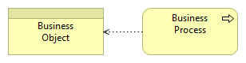
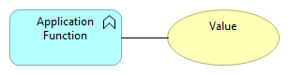
Composition
Aggregation
Assignment
Realization
Used By
Access
Association
Notes:
FEAR NOT

Slide 12
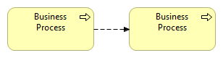
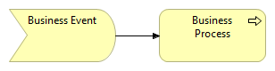
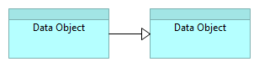
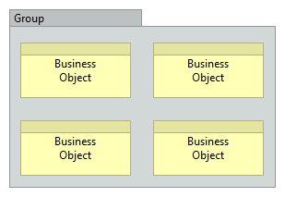
Flow
Trigger
Specialisation
Grouping
Notes:
FLOW in 3.0 has an OBJECT on it → IMPORTANT!
GROUPING in 3.0 has a FUNCTION – the relationships are the same for ALL in the group

Slide 13
7: Relationships
Specification
Structural
Dynamic
Other
Notes:
P67 7.4 summary of STRUCTURAL relationships

Slide 14
Which STRUCTURAL relationship links behavioural and active elements? Which OTHER relationship could you use to generalize?
Notes:
REFER TO page 67 – table 4

Slide 15
Language
Notation
Deliverables
VIEWPOINTS
Notes:
Deliverables = Diagrams & Catalogues

Slide 16
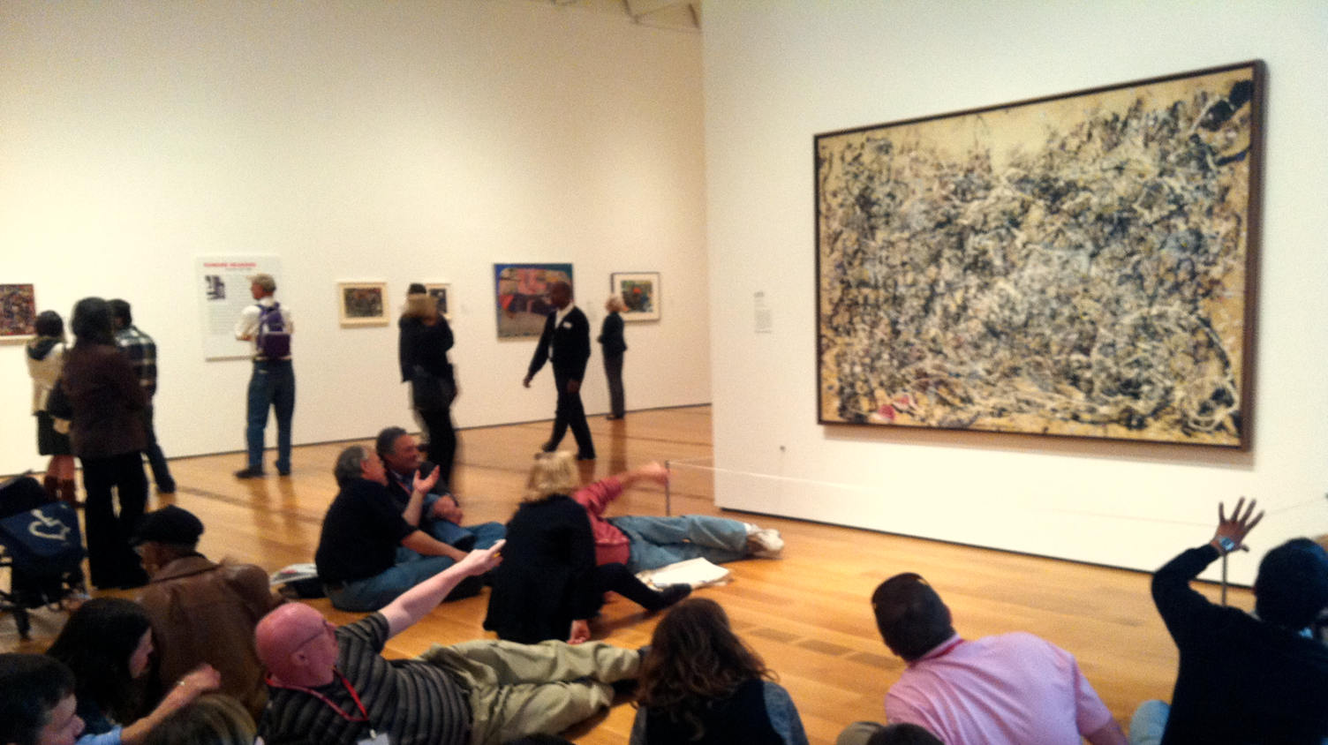
FORM AUDIENCE MESSAGE
Notes:
VIEWPOINTS LIST →
SPECIFIC about the FORM
Of a particular MESSAGE
To a particular AUDIENCE
< OVER-WORK
< OVER-THINKING
< VARIATION
< ABSENCE of INFORMATION
AS-IS vs TO-BE
BEFORE & AFTER VIEWPOINTS

Slide 17
End Users
Architects
Upper Management
Operational Managers
Project Managers
Developers
Composition
Support
Co-operative
Realization
How things break down
Organization Charts
Information Structures
How things are used
Products
How things get implemented
Service Realization
Implementation & Deployment
How things work together
Application Co-operation
Actor Co-operation
Application Usage
Technology Usage
Notes:
Check out the Archimate online documentation for a list of viewpoints

Slide 18

TECHNIQUE PRODUCTS PROCESS PEOPLE
Notes:
IDEAL – in ENGLISH – takes the project scope and determines the EXACT
AGREEMENT on OUTPUT – QUALITY, RESOURCES, and TIME
If you know the MESSAGE and the AUDIENCE ← FORM from VIEWPOINTS
MEANS CONTROL – SPECIFIC deliverables, CLEAR results, and QUALITY built in

Slide 19
Which viewpoints are your viewpoints? What tools do you use to draw them? What message do they send?

